Slide 1
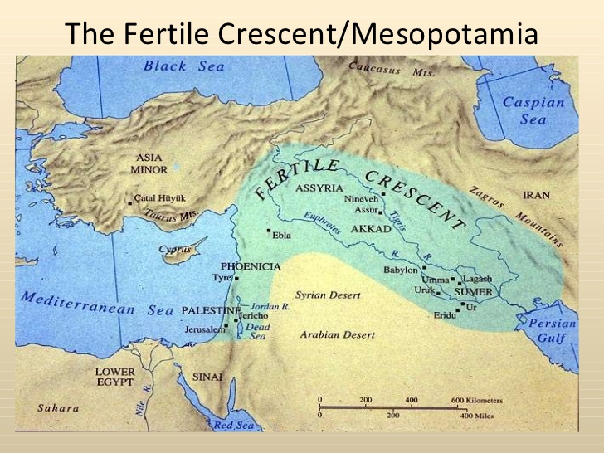
Mesopotamia:
Cradle of Civilization
Settled agriculture began in Mesopotamia around 10,000 B.C.E. with the cultivation of wheat and barley
By 8,500 B.C.E. the domestication of plants and animals was widespread
By 8,000 B.C.E. small farming communities were spread across the Fertile Crescent

Slide 2
Domestication of Plants and Animals
Dogs – around 10,000 B.C.E.
Sheep, goats, cattle and pigs – 9000 to 7000 B.C.E.
Barley, wheat and peas – around 8500 B.C.E.
Oxen – around 4000 B.C.E.
Cat – around 3500 B.C.E.
Horse – around 3000 B.C.E.

Slide 3
Spread of Civilization
Between 4000 – 3000 B.C.E. communities were established along the Tigris and Euphrates River Valleys
Improvements in the plow allowed for larger areas of cultivation
Development of social and institutional structures

Slide 4
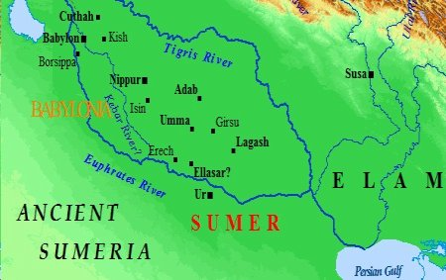
Rise of Sumeria
By 4000 B.C.E. Sumerian communities began to spread throughout Mesopotamia
Uruk, the first city of its kind, was established around 3500 B.C.E.
About 3000 B.C.E. the Sumerians created cuneiform, a form of writing
These ideas spread to the river valleys of Egypt, India and China

Slide 5
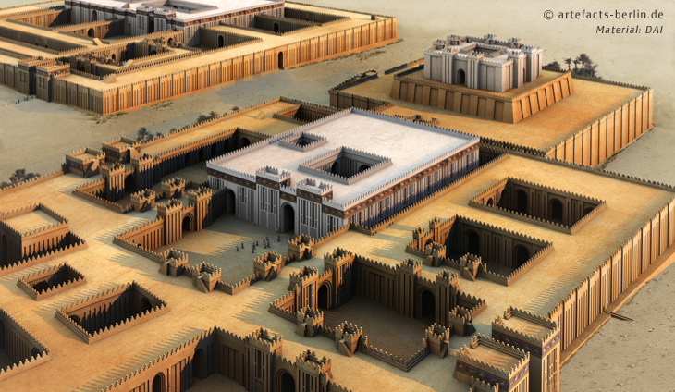
Uruk
Founded in southern Mesopotamia around 3500 B.C.E.
By 3000 B.C.E. had a population of 10,000
At its peak in 2900 B.C.E. had a population of over 50,000
First city of its kind in the world

Slide 6
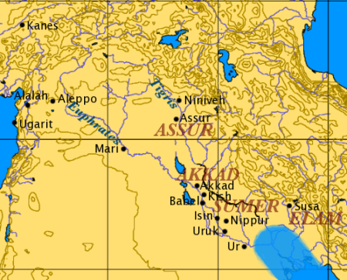
The Sumerians
The 1st urban civilization
Around 3000 B.C.E. cuneiform was developed for trade and government
Walled cities began to appear around 2500 B.C.E.
By 2100 B.C.E. dynastic ruling families began to establish city-states
City-states were organized around a temple with a ruling priest class

Slide 7
The Sumerians
Developed irrigation and canal systems to expand agricultural land
Developed an early form of mathematics around 3500 B.C.E.
New technologies included the wheel, writing, chariots and bronze
Conducted commerce throughout the region

Slide 8
The Sumerians
Practiced polytheism
The work The Epic of Gilgamesh is written around 2100 B.C.E.
The city of Ur was a major trading port
Continued warfare between city-states led to the rise of kings
Developed siege warfare
Use of the chariot in battle around 2500 B.C.E.
Notes:
Why the chariol chanc bucouce now is the fast and qucaly

Slide 9
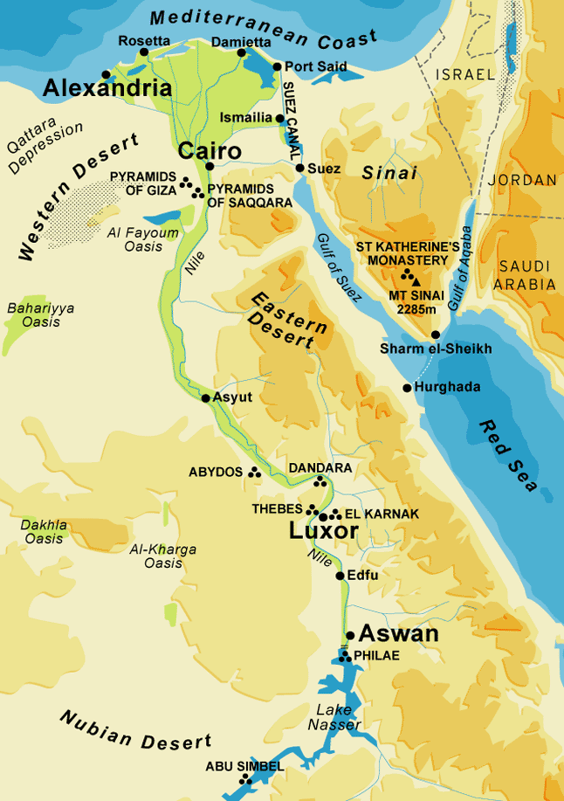
Rise of Early Egypt
By 5500 B.C.E. farming communities were established along the Nile River
Creation of hieroglyphics, or writing, around 3200 B.C.E.
Upper and Lower Egypt united around 3100 B.C.E. creating the 1st Dynasty
Most of the population lived along the Nile River

Slide 10
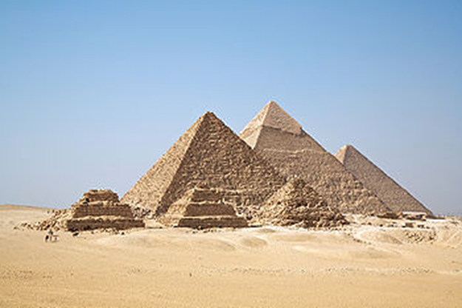
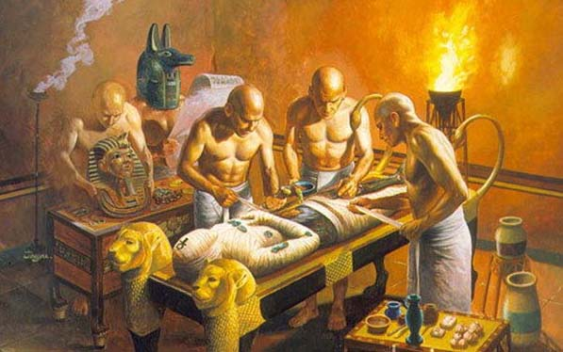
Old Kingdom
1st step pyramids built in Memphis around 2650 B.C.E.
Great Pyramids of Giza built around 2560 B.C.E. for Khufu and his sons
The practice of mummification of kings and elites begin

Slide 11
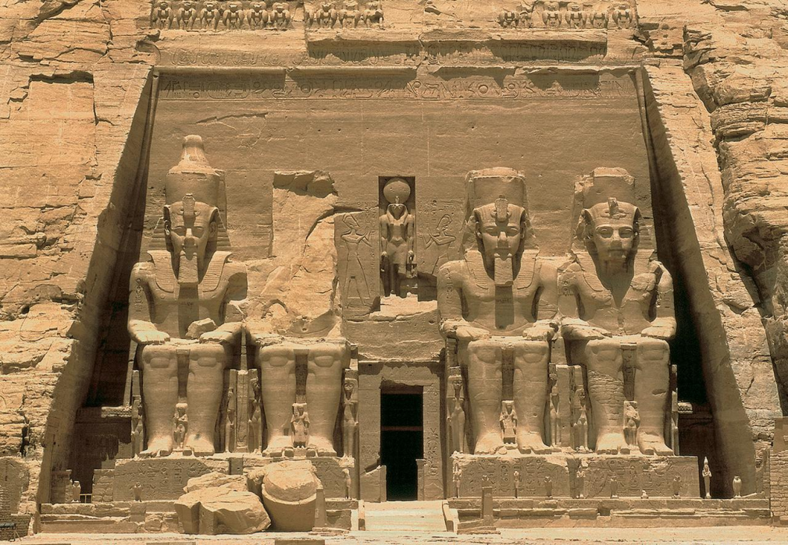
New Kingdom
1575 – 1087 B.C.E.
Most prosperous period of Egypt
Increase in food production and population
Conducted commerce throughout the region
Reached its peak of power under Amenhotep III around 1360 B.C.E.

Slide 12
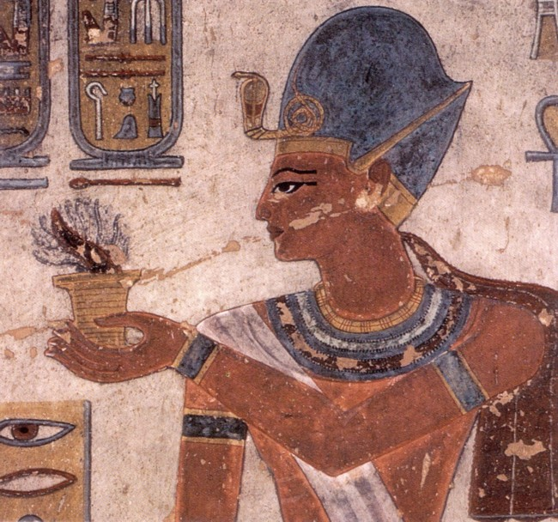
Decline of Egyptian Power
Drought, migrations and constant warfare greatly weakened
Egyptians and Hittites clash in the struggle for dominance in the region in 1274 B.C.E. at the Battle of Kadesh
Internal conflict erupted following the death of Rameses III in 1155 B.C.E.
Upper Egypt broke away in 1087 B.C.E.

Slide 13
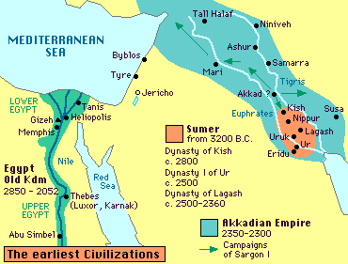
The Rise of Assyria
The city of Ashur was established around 2600 B.C.E.
Dominated by Sumerian kings of the region
The city-state of Ashur was established around 2100 B.C.E. as a kingdom
Most of the population was semi-nomadic tribes
Became a regional power around 2025 B.C.E.

Slide 14
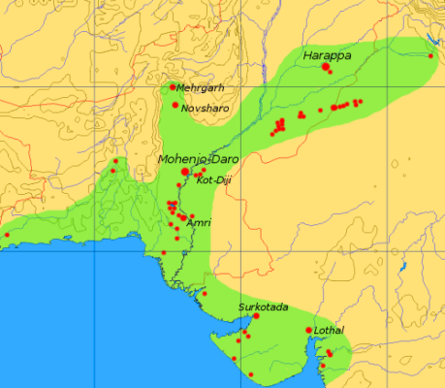
Indus River Valley Civilization
Settled agriculture began around 9000 B.C.E. and was widespread by 6000 B.C.E.
Rise of urban centers around 2600 B.C.E.
By 2000 B.C.E. staple crops included wheat, beans, barley, rice, tea, cotton and bananas
Covered nearly 500,000 square miles

Slide 15
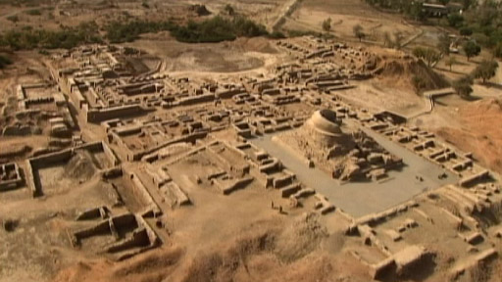
Harappan Culture
2300 – 1800 B.C.E.
By 2300 B.C.E. Harappa became a leading urban center
Harappan culture was widespread by 2100 B.C.E.
Development of political, economic, social, military, cultural, intellectual, religious and scientific structures and institutions

Slide 16
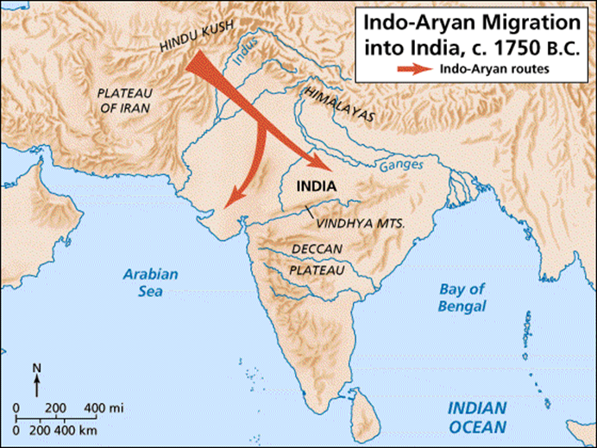
Vedic Aryans
1800 – 500 B.C.E.
Aryans, nomadic herders from central Asia, migrated into the Indus River Valley around 1800 B.C.E.
Migration led to conflict with local peoples
Created a new Indian society based on Aryan culture and institutions

Slide 17
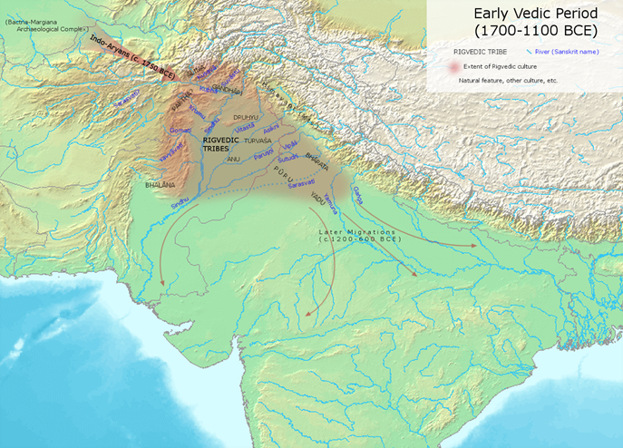
Vedic Aryan Civilization
Introduced Indo-European languages and new religious ideas into northern India
Vedas, the oldest scriptures of Hinduism, introduced around 1700 B.C.E.
Tribal conflicts led to loose confederations
Spread to the Ganges River Valley by 1200 B.C.E.

Slide 18
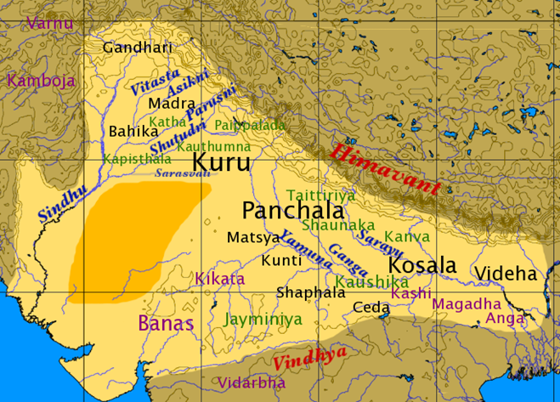
Vedic Aryan Civilization
Introduction of settled agriculture around 9000 B.C.E.
Intermingling of traditions and practices with local peoples
Introduction of the four classes, or varnas, today known as the caste system in India

Slide 19
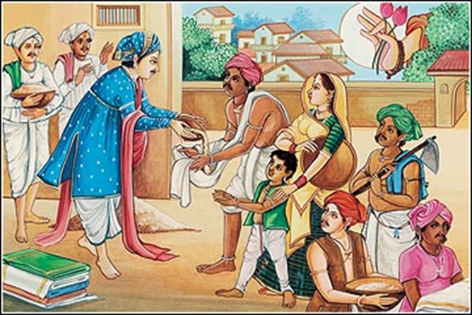
Old Classes, or Varnas
The Brahman priest interpreted the Vedic text for the commoners
The Kshatriya, or warrior class, was the nobility or ruling class
The commoners
The laborers
Each “Janis”, or sub-class was divided

